Slide 1
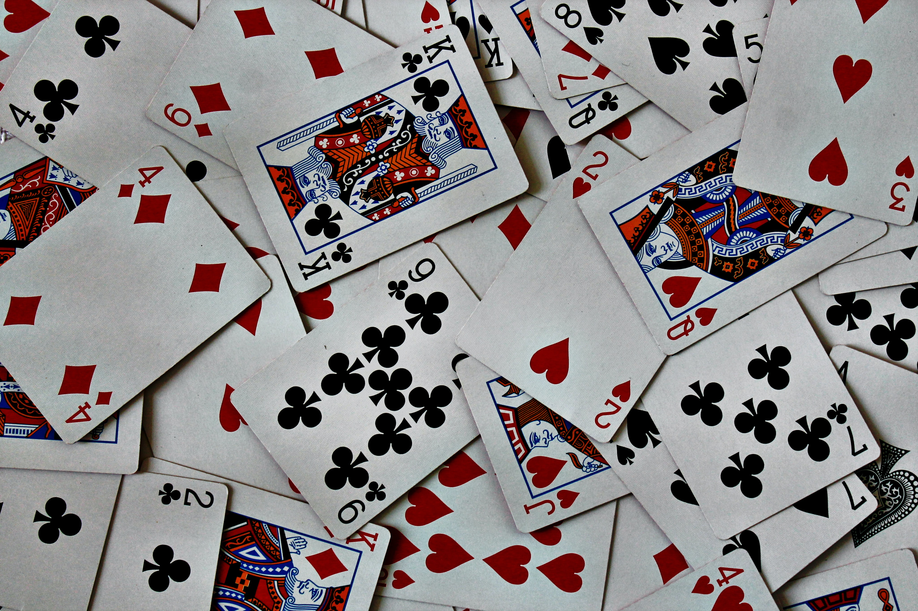
A Survey of Monte Carlo Tree Search Methods

Slide 2
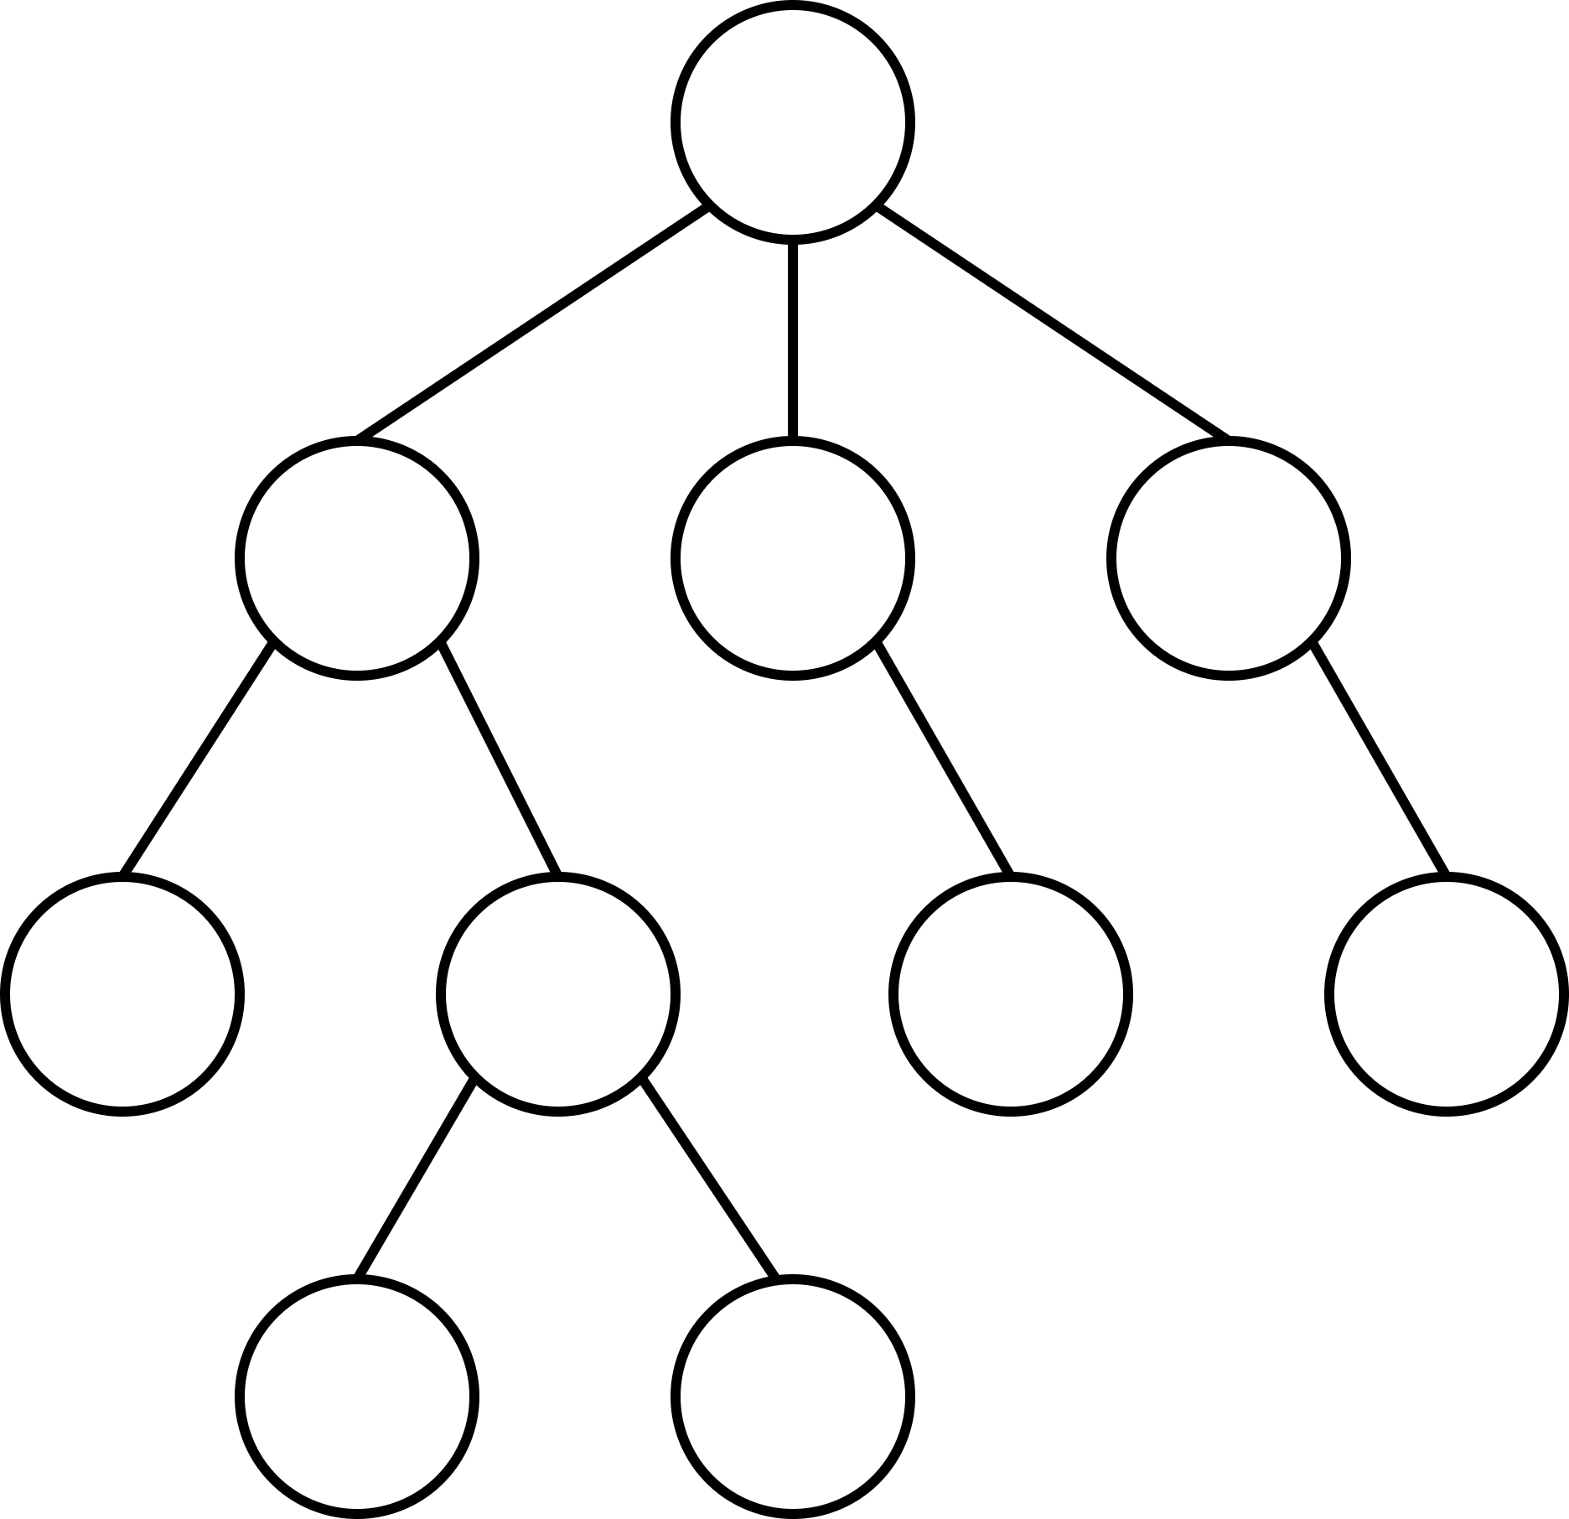
Introduction
Consider a game-playing agent
How to find good/best next move?
Game represented as a game tree
Nodes represent (subset of) states
Still too large to check all actions
Idea: Combine sampling and tentative rewards
refine “view” of the current game tree iteratively
Don’t overthink the term “game”
Generally applicable search algorithm
state of game
(legal) action

Slide 3
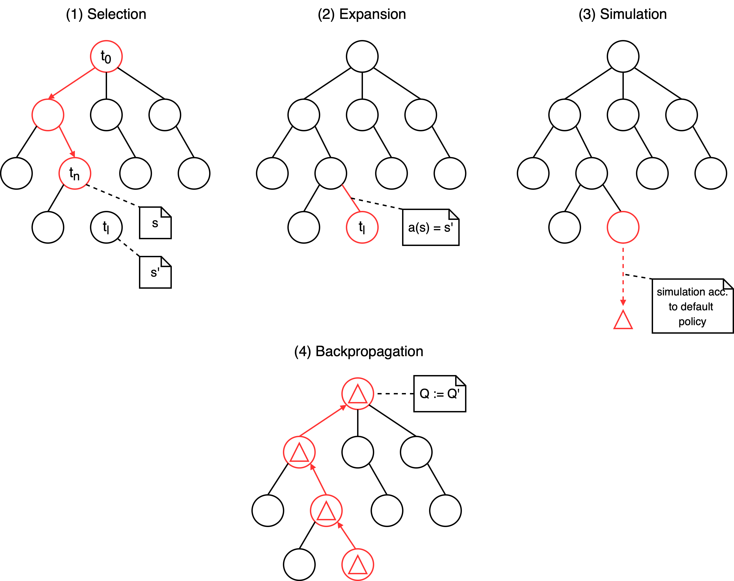
Basics: Monte Carlo Tree Search

Slide 4
Basics: Setting
s(v) – state s represented by node v
a(v) – incoming action a of node v
Q(v) – total simulation reward of v
N(v) – number of times v has been visited
v
s(v)
a(v)
Q(v)
N(v)
v
a₀
a₁
a₂
v‘
v‘‘
v⁽³⁾

Slide 5
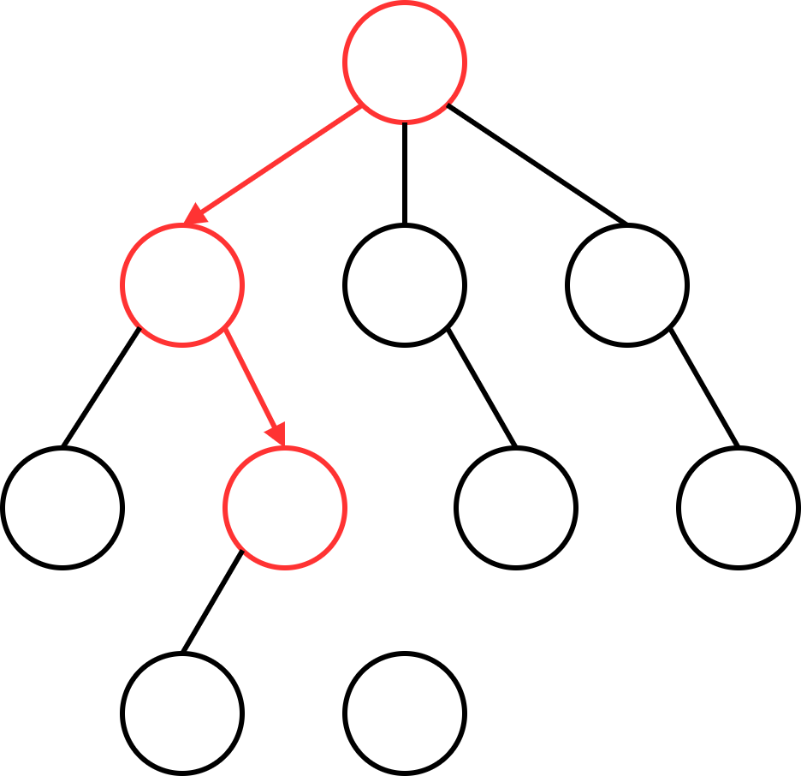
Basics: Monte Carlo Tree Search
First Step: Selection
Controlled by the Tree Policy
Transfer: Multi-Armed Bandit Problem
T-times: pick some action
collect associated reward
maximize total reward
Later: UCT

Slide 6
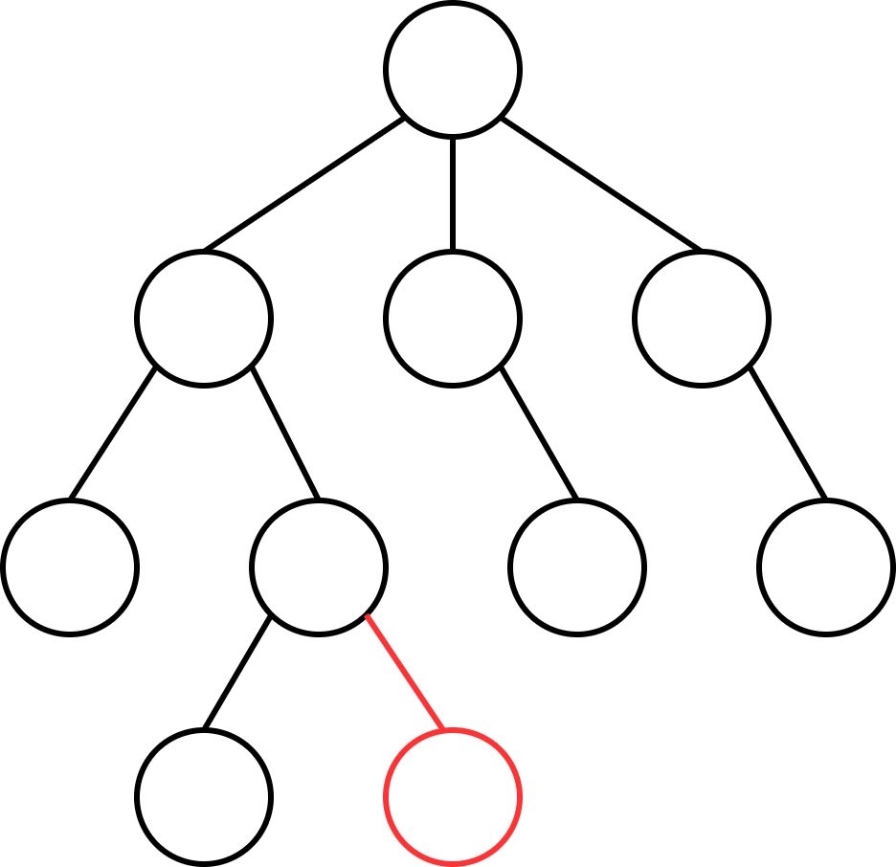
Basics: Monte Carlo Tree Search
Second Step: Expansion
Controlled by Tree Policy
Transfer: Multi-Armed Bandit Problem
T-times: pick some action
collect associated reward
maximize total reward
Later: UCT

Slide 7
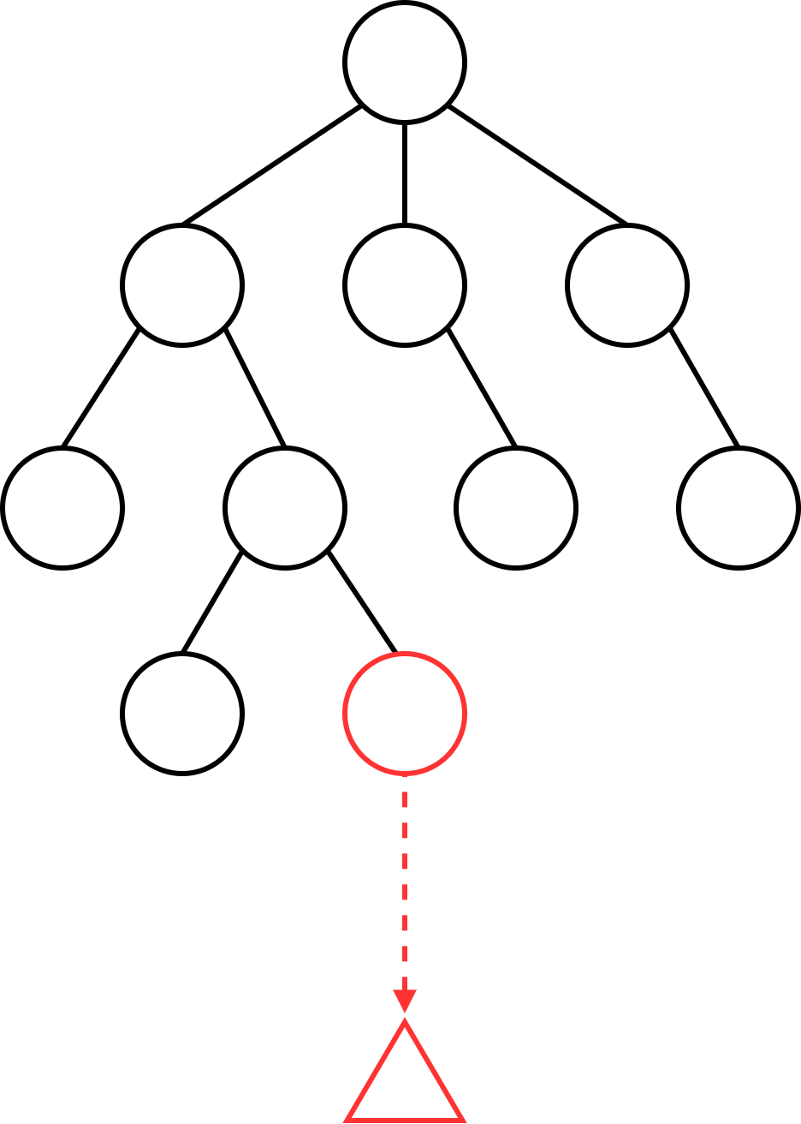
Basics: Monte Carlo Tree Search
Third Step: Simulation
Play out a game
i.e. execute actions until a terminal state is reached
evaluate result
Controlled by Default Policy
Details to consider:
speed vs. quality
complexity of evaluation function

Slide 8
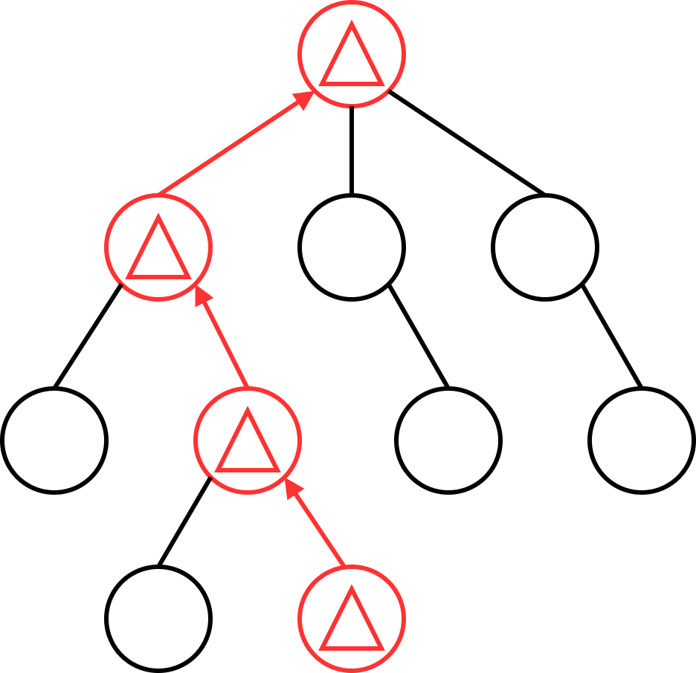
Basics: Monte Carlo Tree Search
Fourth Step: Backpropagation
Update values of
Q(v)
N(v)
Can be modified by heuristics
later - AMAF

Slide 9
Basics: Monte Carlo Tree Search
About iterations:
While the computation budget is not exhausted:
execute the four steps as many times as possible
Increase tree size and number of evaluated states
Finally, pick the best one
Time-constraints are crucial
real-time, turn-based games

Slide 10
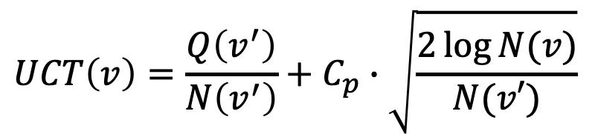
Basics: UCT
“Upper Confidence Bound for Trees”
Exploitation: Follow discovered path deemed valuable
Exploration: Discover new paths
“Exploitation“
$$UCT\left(v\right)=\frac{Q\left(v^{′}\right)}{N\left(v^{′}\right)}+C_{p}∙\sqrt{\frac{2\log{N(v)}}{N(v′)}}$$
“Exploration“

Slide 11
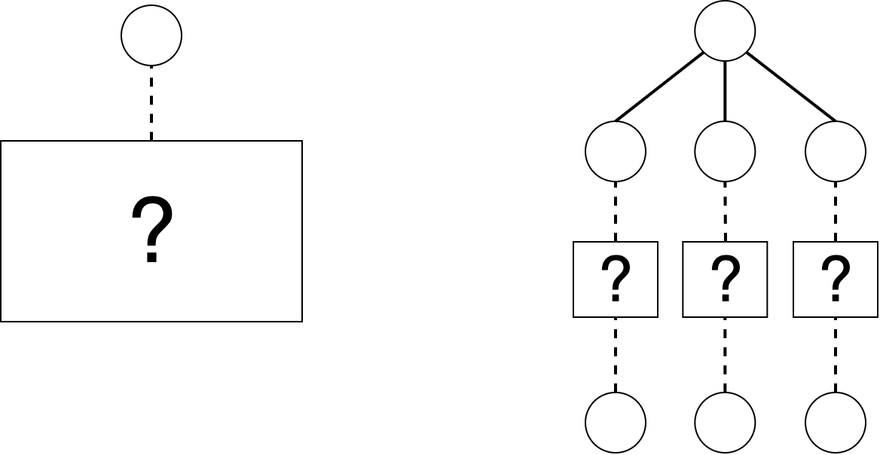
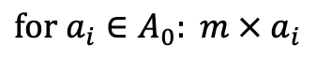
Heuristics: BFS-Tree Initialization
Before MCTS: execute each available root-action
Information gained can guide algorithm
$for a_{i}∈A_{0}: m × a_{i}$

Slide 12
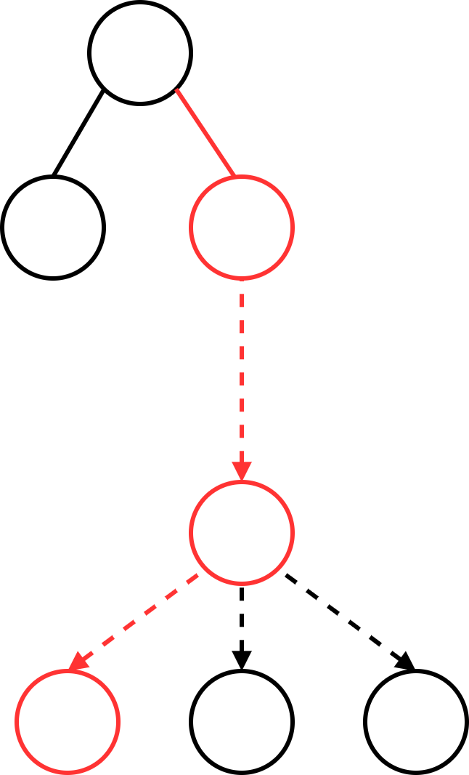
Heuristics: Loss Avoidance
Ignore negative results when encountering new nodes
If unvisited node represents a loss, generate neighbors
Backpropagate only best-case scenario
Similar (inverse) approach for overly optimistic evaluations
result of simulation
generated states

Slide 13
Heuristics: Novelty-based Pruning
Problem: Many similar states and redundant paths
Solution: Use a novelty measure nov(v), all nodes above a threshold are pruned
Step 1: For node v, define a neighborhood of other nodes
Step 2: Compare nodes in the neighbohood to v, giving us their similarity or novelty
Step 3: Prune v if it is too similar to any other nodes

Slide 14
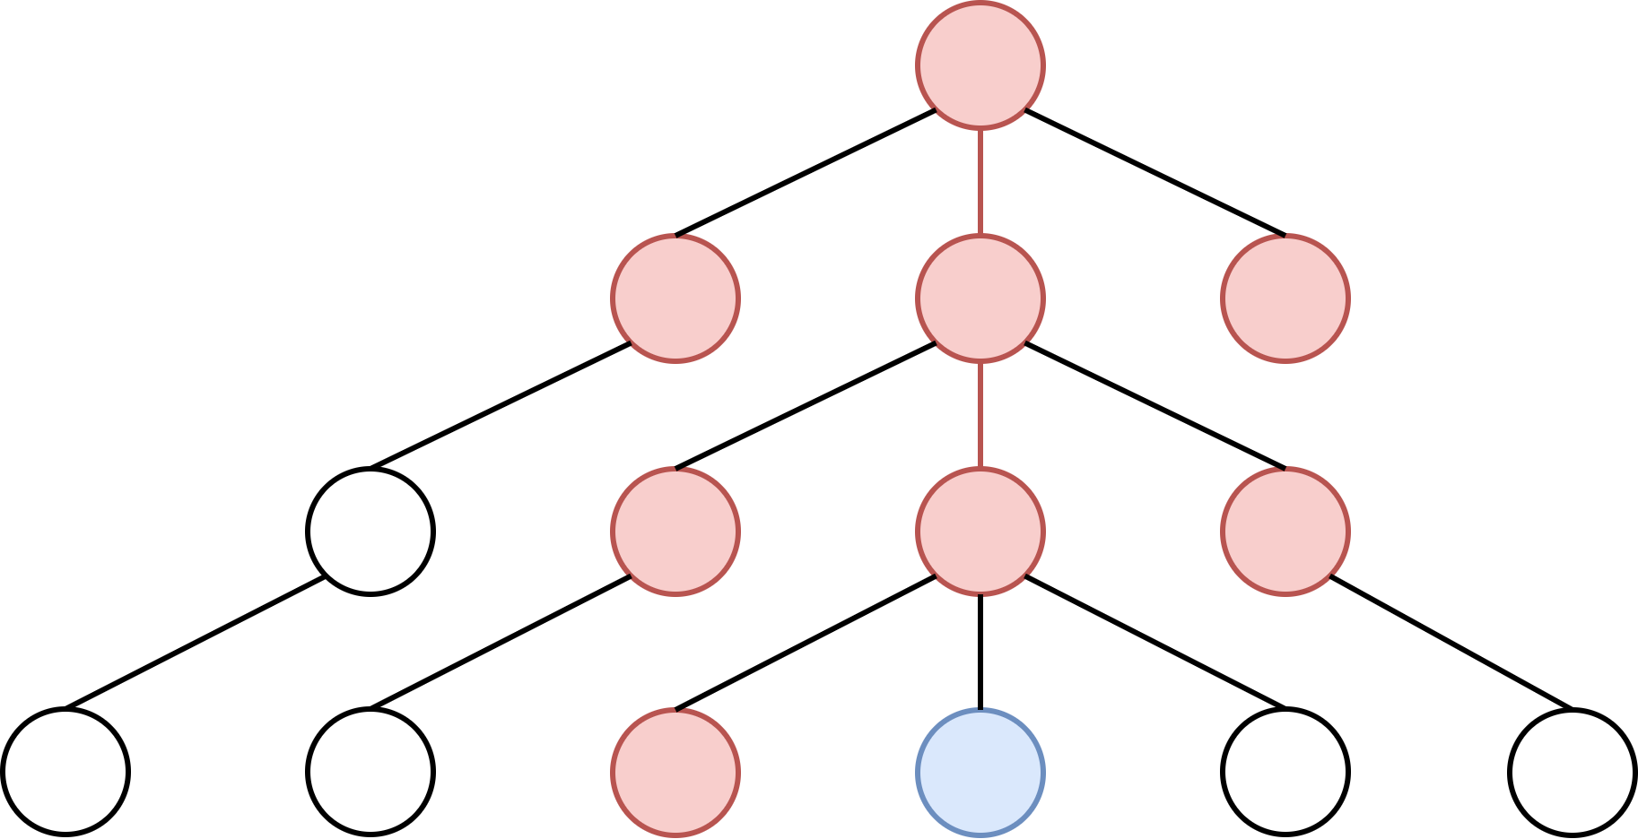
Heuristics: Novelty-based Pruning
Step 1: the neighboorhood N(v) is the union of
the left siblings of v
the parent of v: p(v)
all siblings of p(v)
the neighborhood of p(v)
v
p(v)

Slide 15
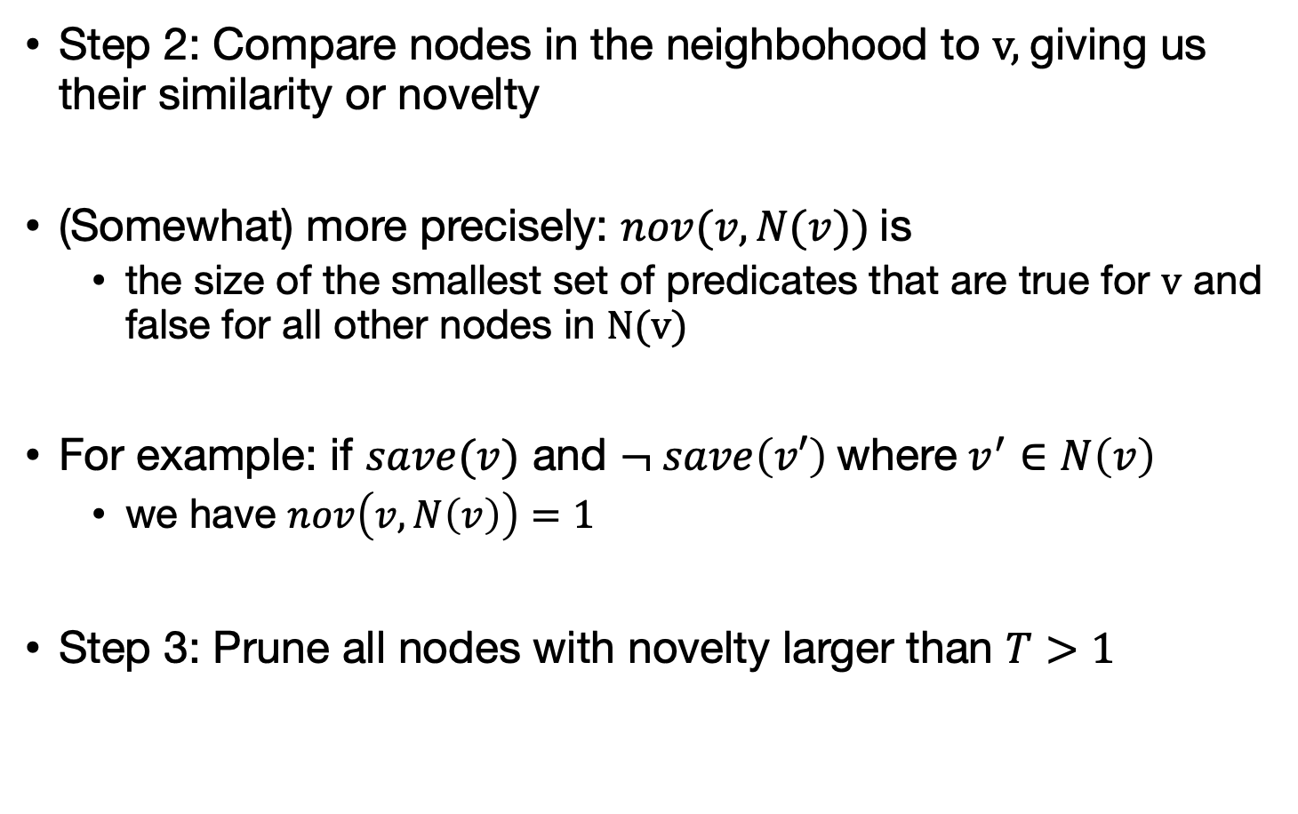
Heuristics: Novelty-based Pruning
Step 2: Compare nodes in the neighbohood to v, giving us their similarity or novelty
(Somewhat) more precisely: $nov(v,N(v))$is
the size of the smallest set of predicates that are true for v and false for all other nodes in N(v)
For example: if $save(v)$ and $¬ save\left(v′\right)$ where $v^{′}∈N\left(v\right)$
we have $nov\left(v,N\left(v\right)\right)=1$
Step 3: Prune all nodes with novelty larger than $T>1$

Slide 16
Heuristics: Knowledge-based Evaluations
Use A* and knowledge of the game to consider the distance to interesting objects

Slide 17
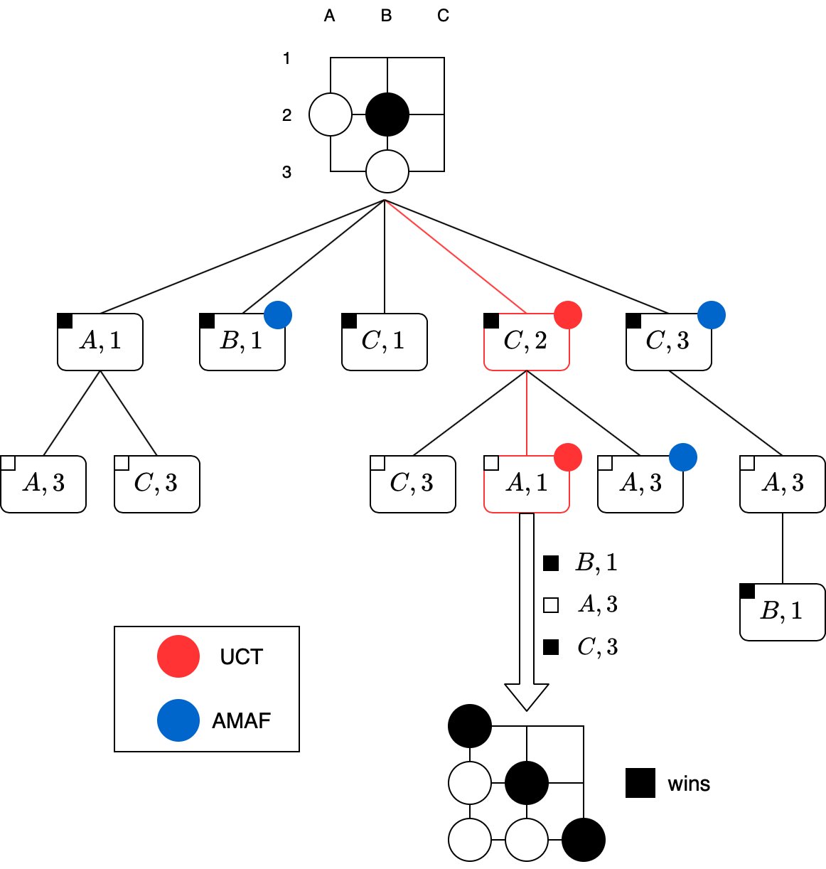
Heuristics: All Moves As First

Slide 18
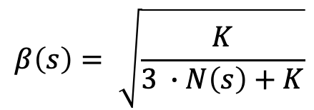
Heuristics: All Moves As First
$$AMAF\left(s,a\right)=β\left(s\right)∙Q\left(s,a\right)+\left(1−β\left(s\right)\right)∙AMAF(s^{′},a)$$
$$β\left(s\right)= \sqrt{\frac{K}{3 ∙N\left(s\right)+K}}$$
where

Slide 19
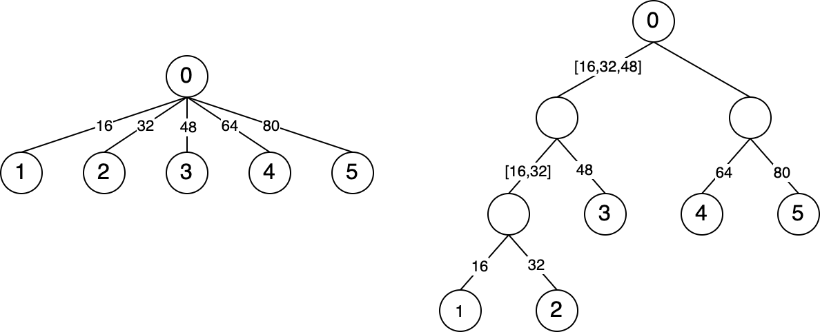
Extension: Tree Compression
Control size and width of tree when there are many paths
Binary-search
Inspired by: Deep Architect

Slide 20
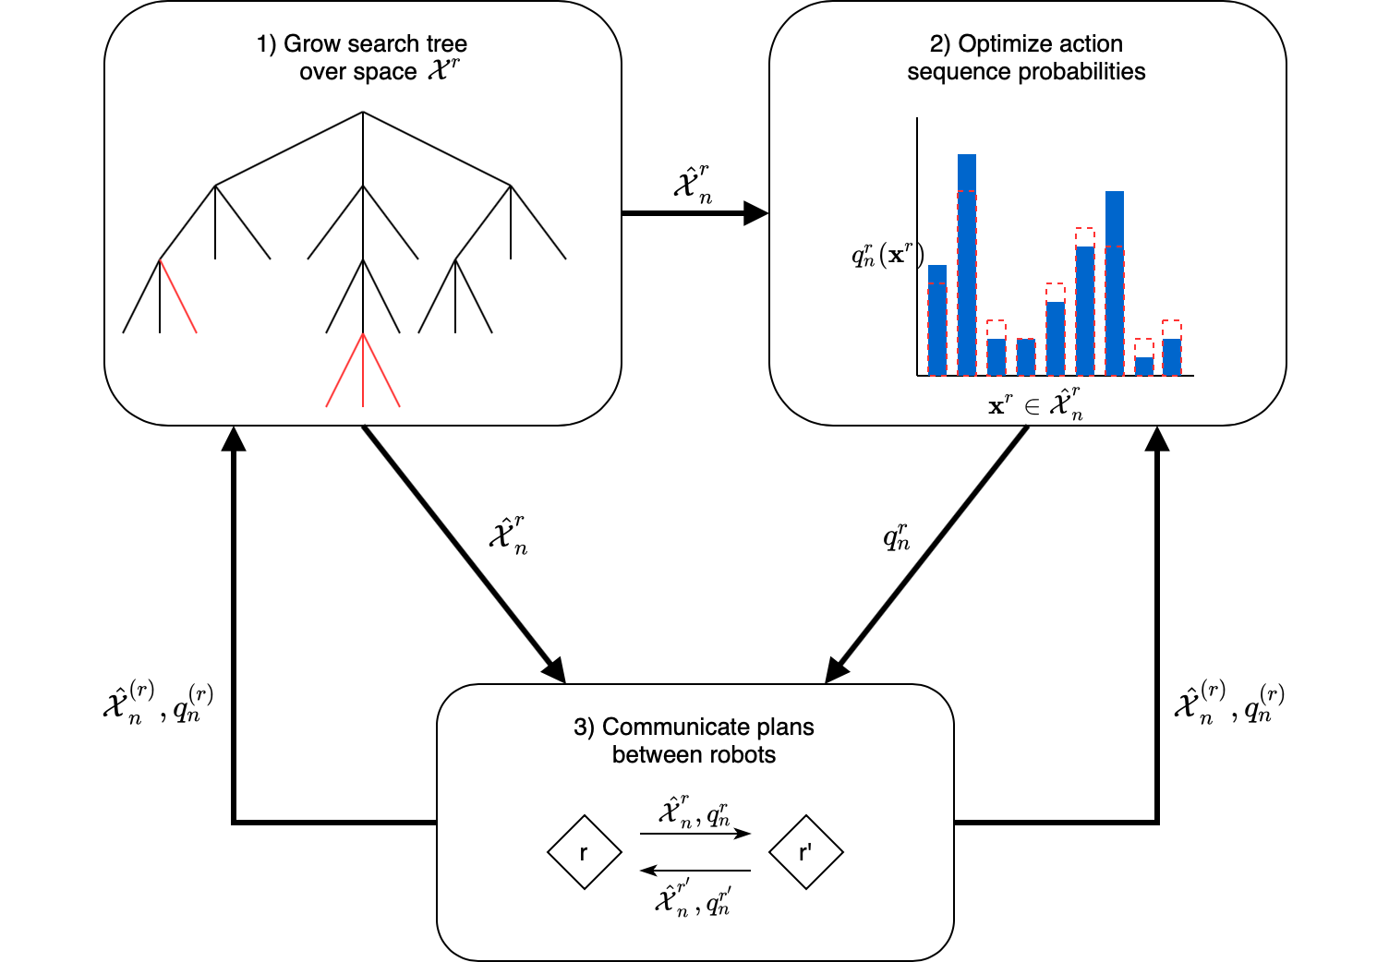
Applications: Dec-MCTS

Slide 21
Applications: Evolutionary Algorithms

Slide 22
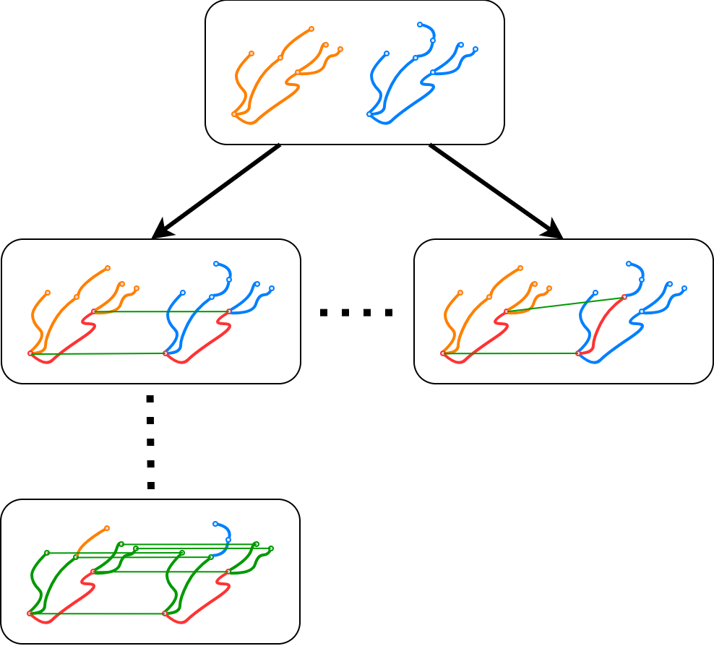
Applications: Geometrical Graph Matching

Slide 23
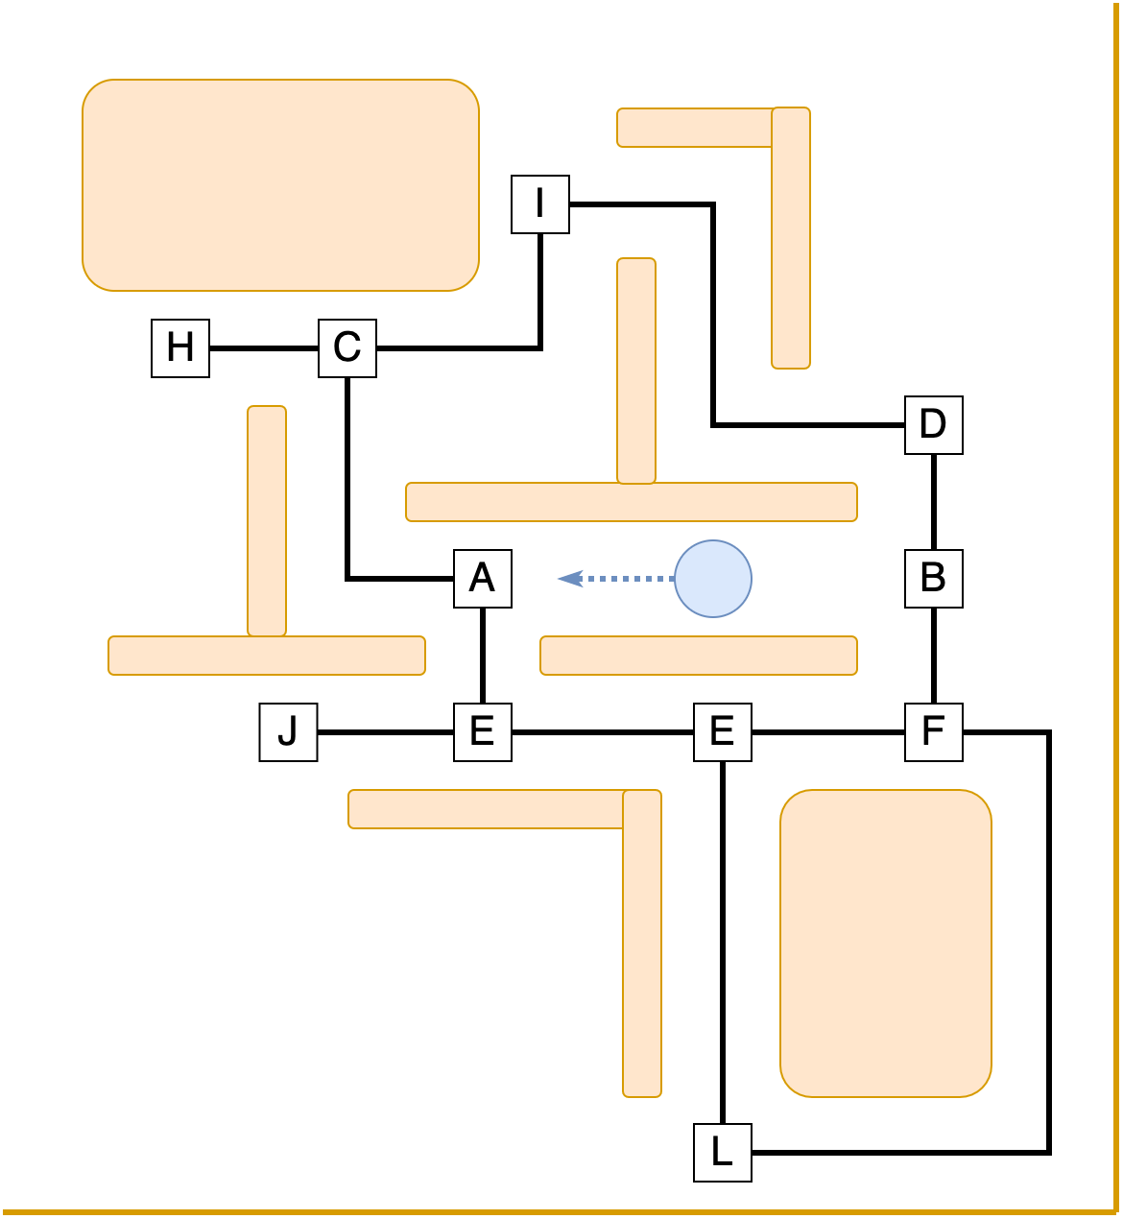
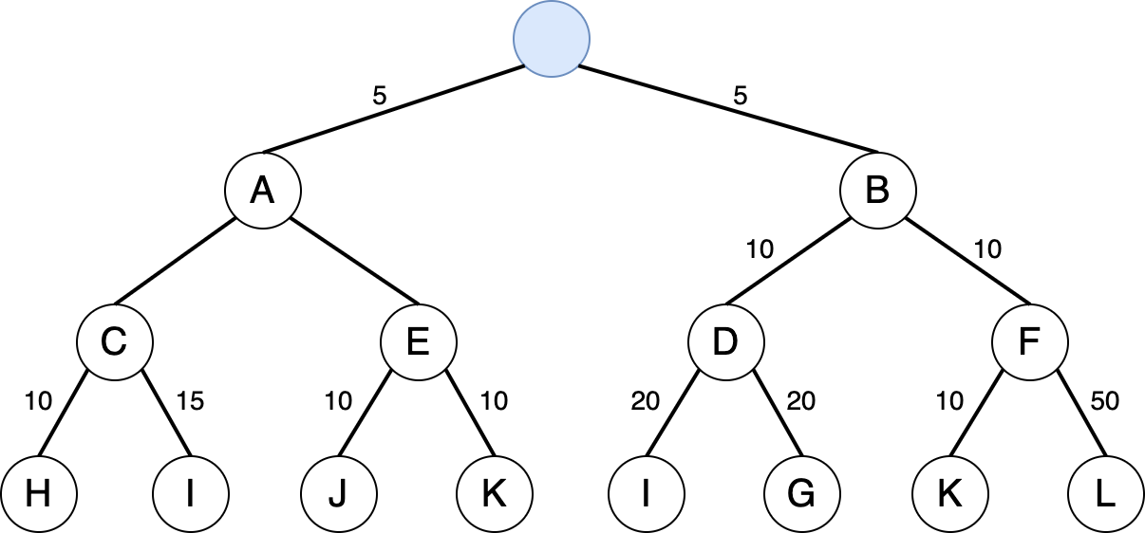
Applications: Ms Pacman

Slide 24
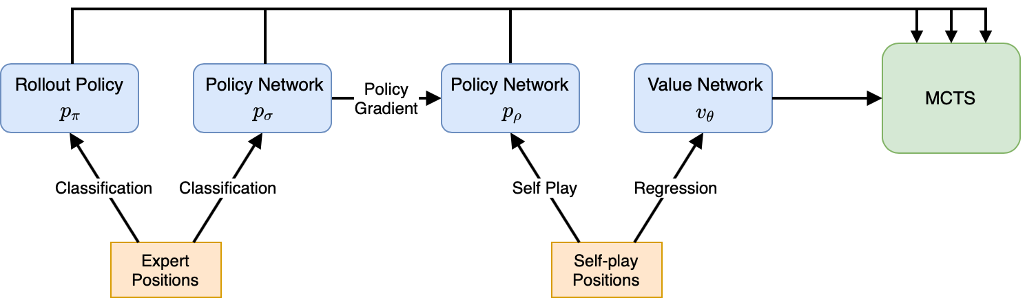
Application: AlphaGo
ML-System that beat some of the world’s greatest players in the game of Go
MCTS used to train a neural network

Slide 25
Conclusion
MCTS – Combine sampling and simulations
Addresses Exploration-Exploitation tradeoff
Works well out of the box but can be extended and tailored to specifics of current domain
Heuristics
Transfer techniques from statistics and probability theory

